Slide 1
小麥網
A Business Networking Solution based on 小米 router
Studio 215

Slide 2
WHY EAP?
EAP : Enterprise Access Point

Slide 3
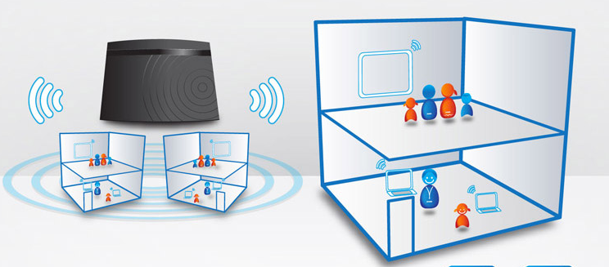
SOHO
Pre-share key
Setup easily

Slide 4
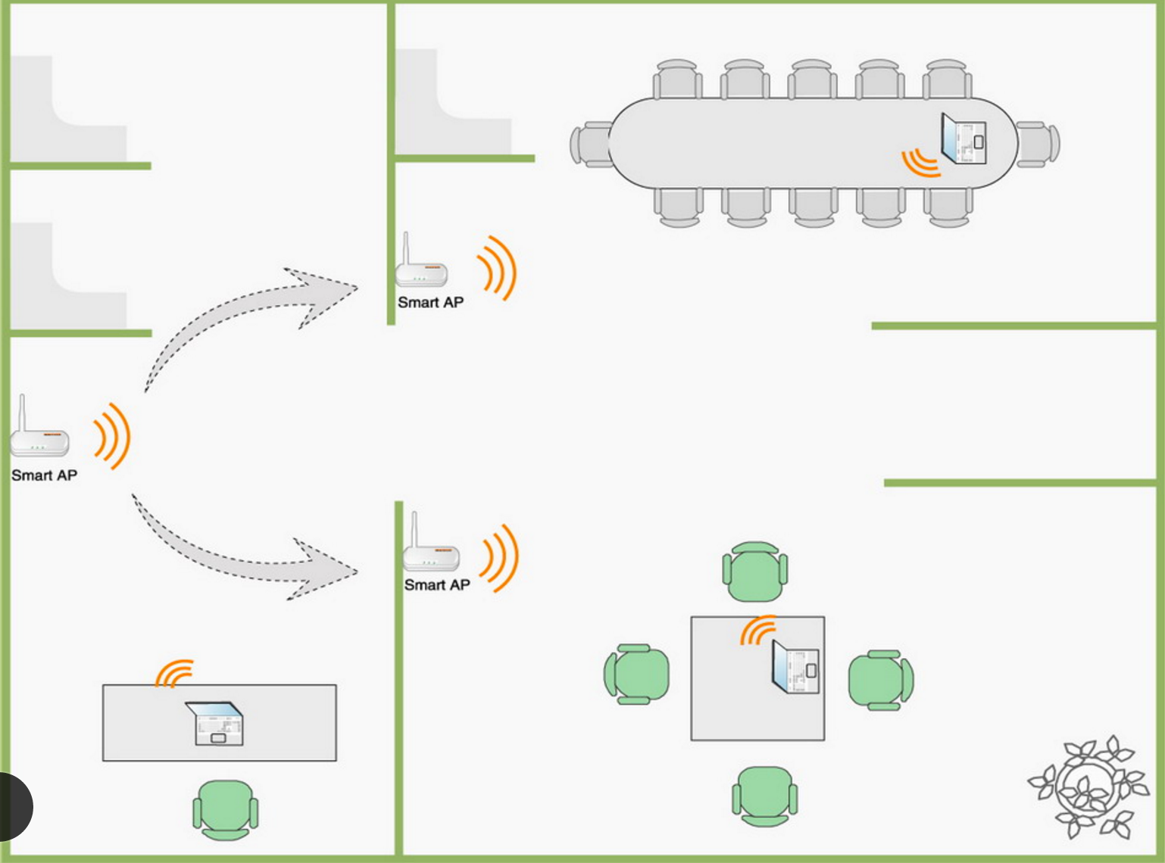
SMB with SOHO AP
Pre-share key
Setup one by one
SMB : Small and Medium Business

Slide 5


SMB with EAP
access controller
Enterprise Authentication
Setup by access controller
SMB : Small and Medium Business

Slide 6
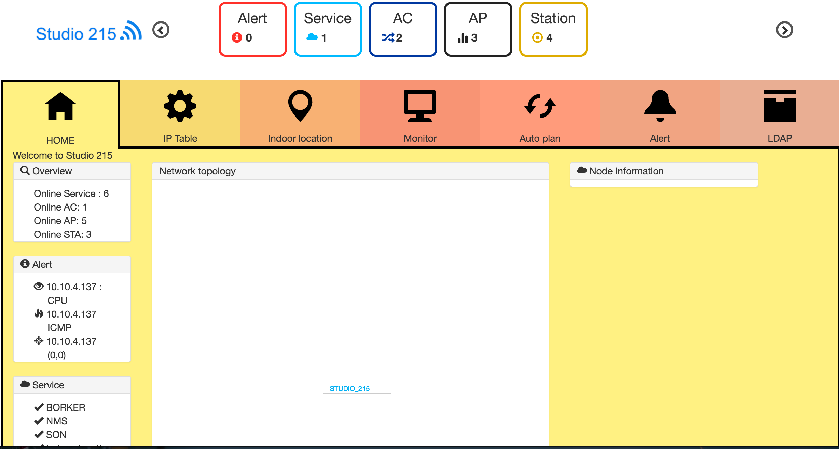
SMB with EAP
Network Management System
SMB : Small and Medium Business

Slide 7

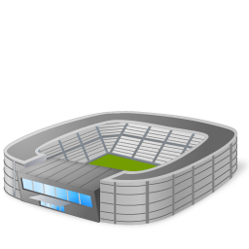

Applicable Environment
Coffee shop
Restaurant
Hotel
City hall
Stadium
Museum

Slide 8
WHY US ?

Slide 9
Mass and Prestige
Aruba : A networking vendor selling enterprise wireless LAN equipment

Slide 10
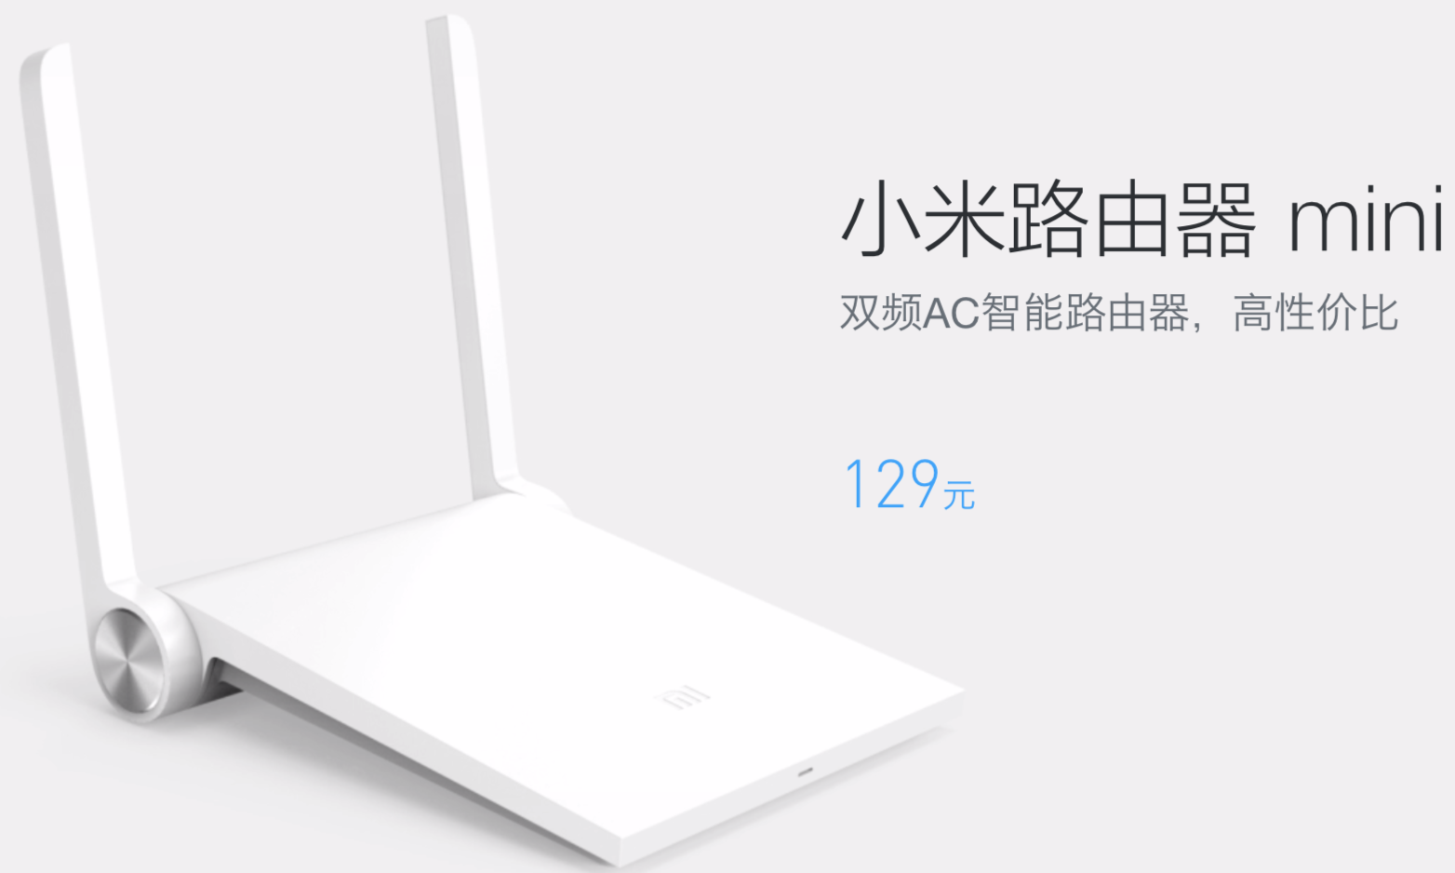


Mass and Prestige
Only needs 10% costs !!

Slide 11
Mass and Prestige
802.11ac /256 QAM/160 MHz channel/ 400ns GI
Cheaper
Using Different Channel

Slide 12
EAP Function Introduction

Slide 13
Function feature
EAP Platform
(HW/FW)
Authentication/ Security/Firewall
SON algorithm
Management SW
Multiple SSIDs
Fast Roaming
Easy Configuration

Slide 14
Function feature
EAP Platform
(HW/FW)
Authentication/ Security/Firewall
SON algorithm
Management SW
802.1X authentication
Radius server
Facebook Wi-Fi
Portal login interface
LDAP

Slide 15
Function feature
EAP Platform
(HW/FW)
Authentication/ Security/Firewall
SON algorithm
Management SW
Dynamic Frequency Selection
Transmit Power Control
Auto Planning

Slide 16
Function feature
EAP Platform
(HW/FW)
Authentication/ Security/Firewall
SON algorithm
Management SW
Network Management System

Slide 17
EAP Platform

Slide 18
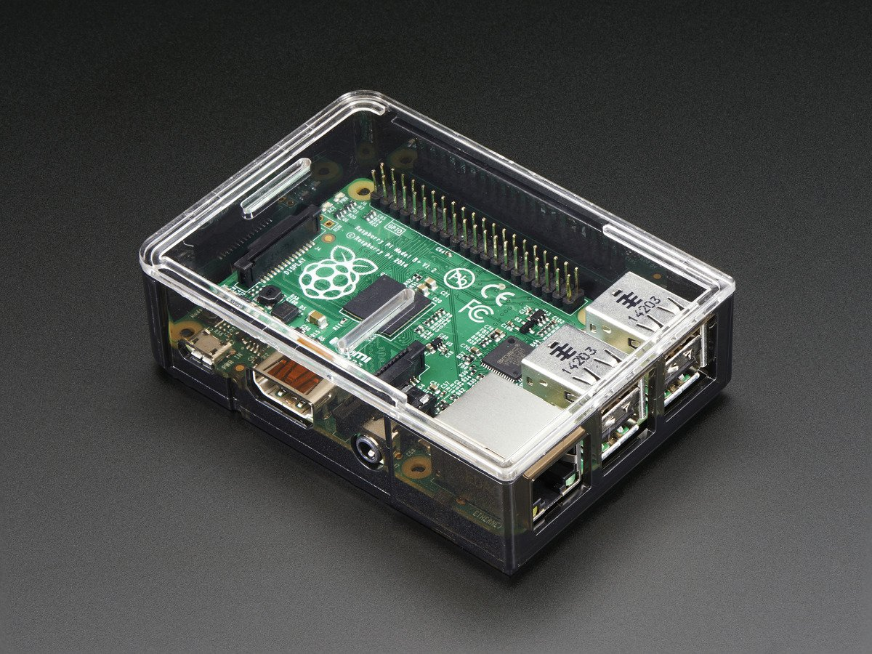
Architecture
Raspberry Pi

Slide 19
EAP Platform
Hardware – 小米路由 mini
Soc Vendor | MTK
CPU/Speed | MT7620A/580MHz
Non-volatile storage | 16M
RAM | 128M
Wireless Standard | 802.11a, 802.11b, 802.11g, 802.11n, 802.11ac
Frequency | 2.4GHz & 5GHz

Slide 20
EAP Platform
Hardware – Raspberry pi
Soc Vendor | BroadCom
CPU/Speed | BCM2837/1.2GHz
Non-volatile storage | SD card(we use 16GB)
RAM | 1GB
Wireless Standard | 802.11n

Slide 21
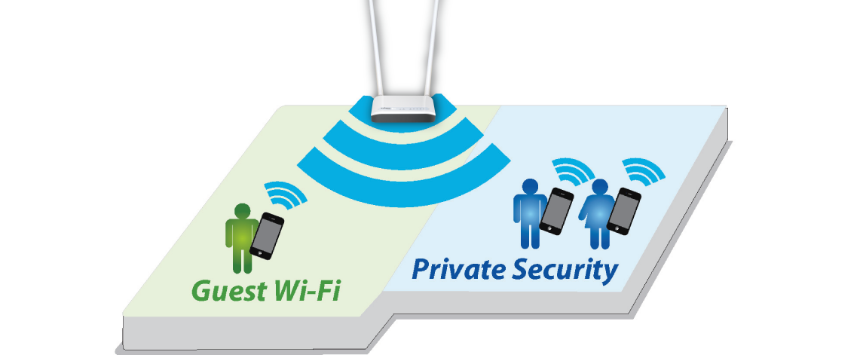
SSID by VLAN Tag
SSID=Enterprise
VLAN=1
------------------------------
50M/30M bps
SSID=Guest
VLAN=2
------------------------------
2M/1M bps
Multiple SSID for security management
Captive portal for authentication
Fast roaming
Traffic control

Slide 22
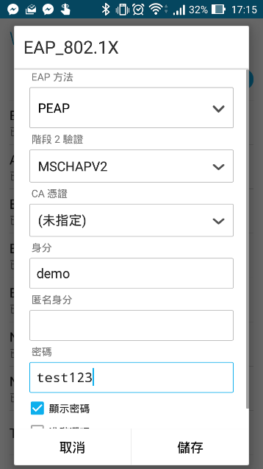

Facebook Login & 802.1x
Facebook
Radius server
SSID=Guest
VLAN=2
------------------------------
2M/1M bps
SSID=Enterprise
VLAN=1
------------------------------
50M/30M bps
wifidog
802.1X

Slide 23
Self-organization Network

Slide 24
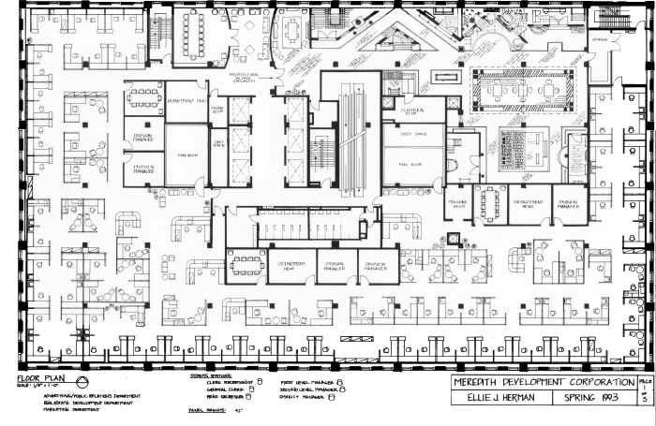
Why Self-organization Network?
High Density Development
Complicate Environment

Slide 25
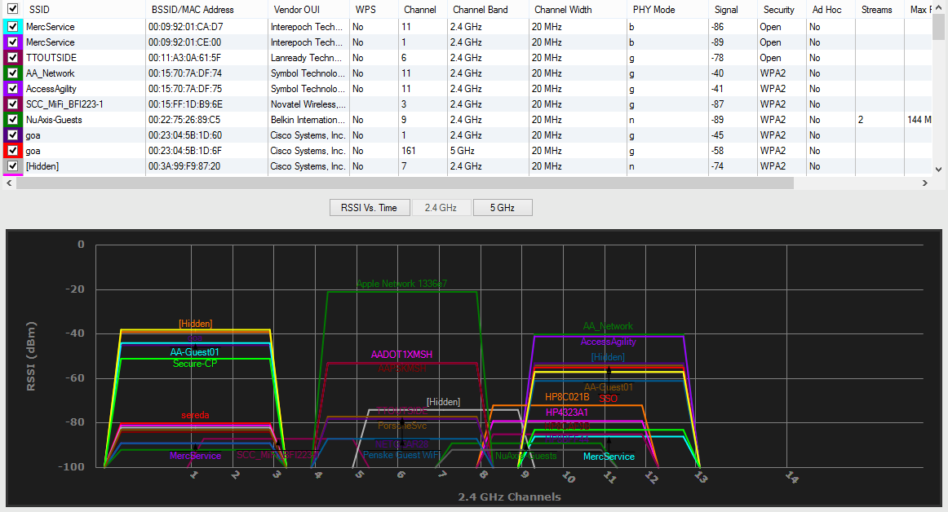
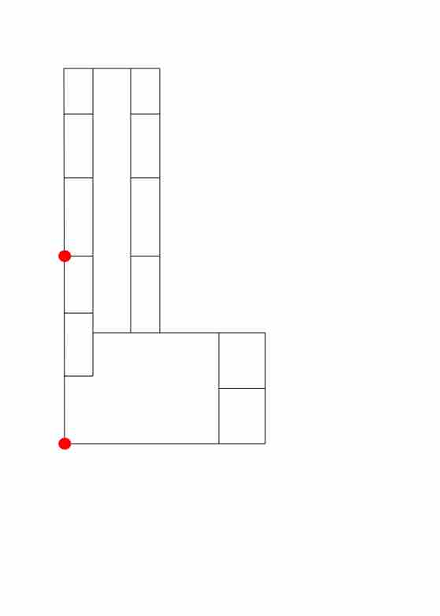
How?
Channel Scan
Period scan
Simulate environment
Construct path loss model

Slide 26
SON feature
Channel Selection
Auto Planning
Transmit Power Control

Slide 27
SON feature
Channel Selection
Auto Planning
Transmit Power Control

Slide 28
Dynamic Channel Allocation

Slide 29
SON feature
Channel Selection
Auto Planning
Transmit Power Control

Slide 30
Transmit Power Control

Slide 31
SON feature
Channel Selection
Auto Planning
Transmit Power Control

Slide 32
Site Survey & Auto Planning
How many APs to satisfy full coverage.
With fixed number of APs, placement of them by satisfying the best coverage.

Slide 33
Network Management System

Slide 34
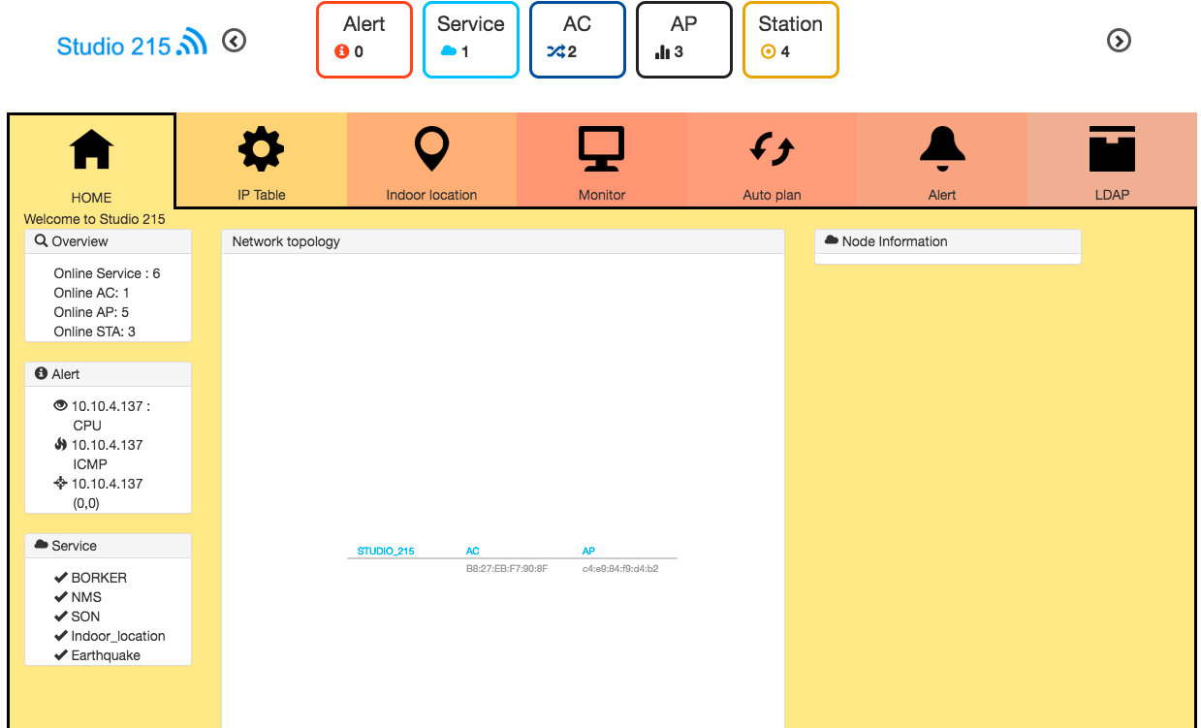

Easy Management & Centralized
Overview
Service 狀態

Slide 35
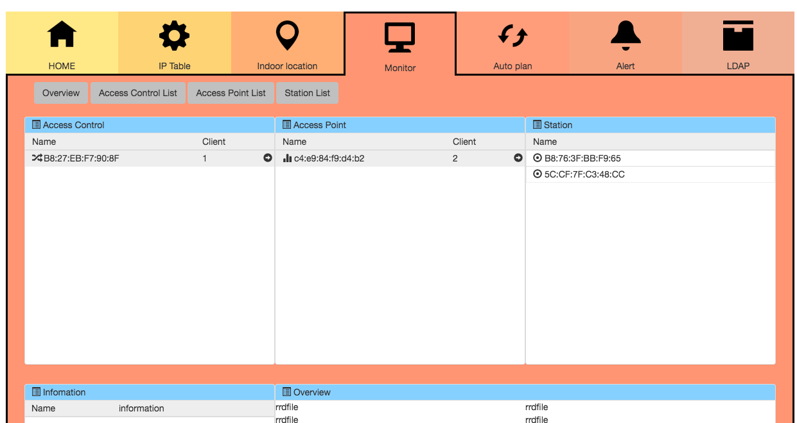
Easy Management & Centralized
AP AC station table
AC list

Slide 36
Easy Management & Centralized
AP AC station table
AP list

Slide 37
Easy Management & Centralized
AP AC station table
station list

Slide 38
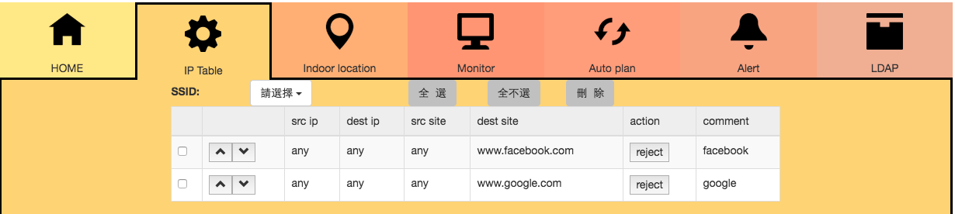
Easy Management & Centralized
IP table setting

Slide 39
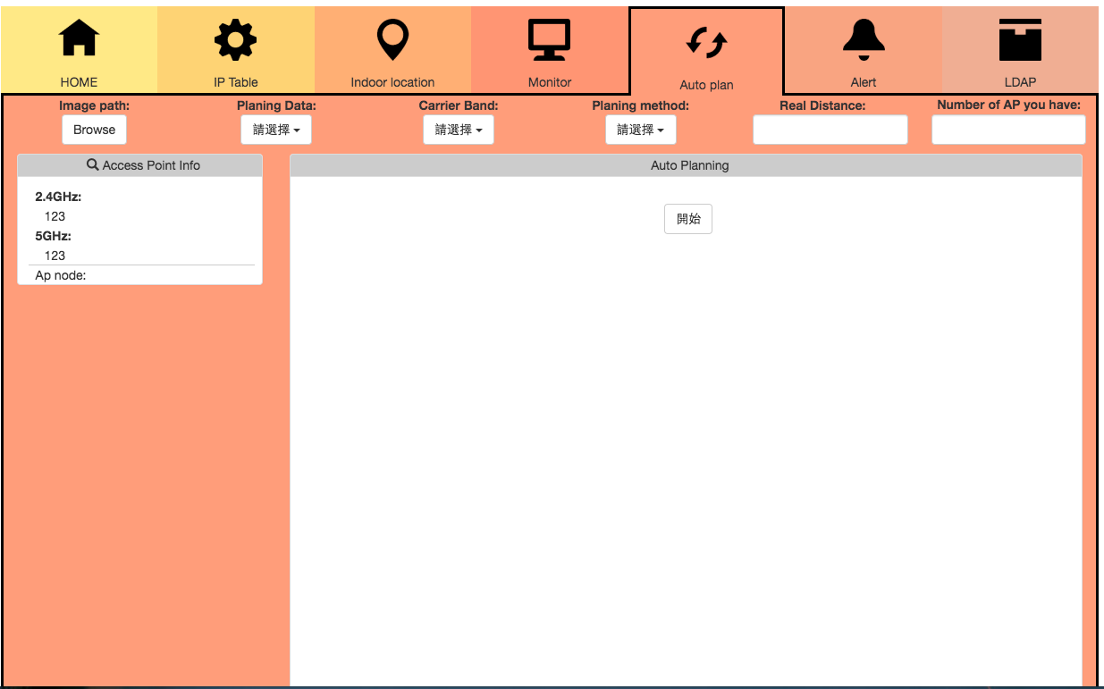
Easy Management & Centralized
Auto Plan

Slide 40
Future Works

Slide 41
Future Works
Indoor Location Services
Mobile Alert

Slide 42
Future Works
Indoor Location Services
Mobile Alert

Slide 43


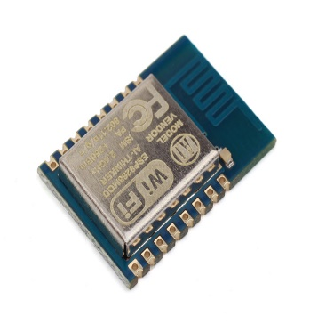
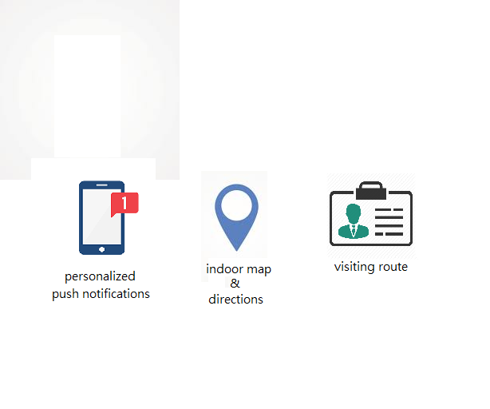

Why
For Store
For Enterprise
personalized
push notifications
indoor map & directions
visiting route
asset tracking

Slide 44

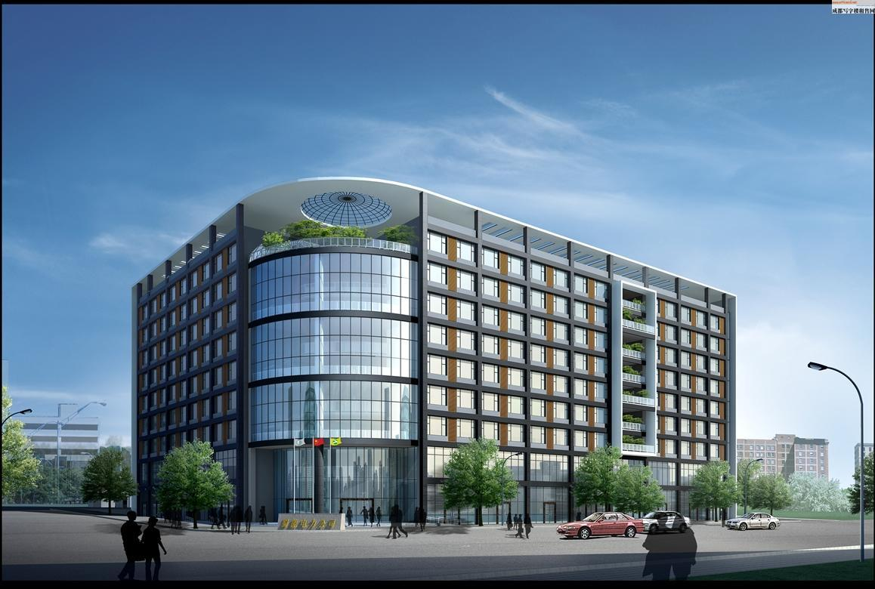
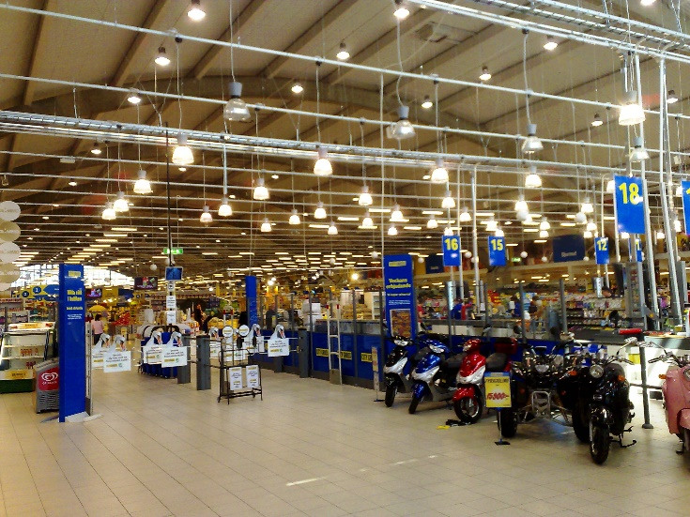

Where
Geo Fencing
Customer
Orientation
Visiting Route

Slide 45
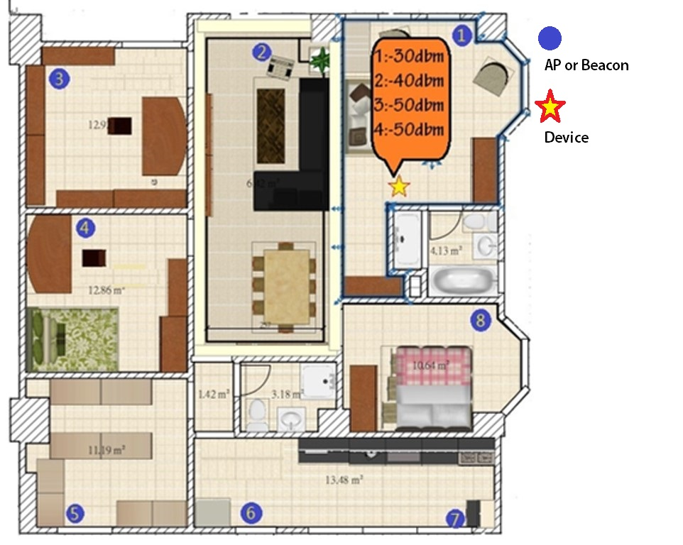
How
ESP8266

Slide 46




Prototype
Send Packet
Device
Sniffing The Packet of Device
&
Get The RSSI
ESP8266
Use The Algorithm
NMS

Slide 47
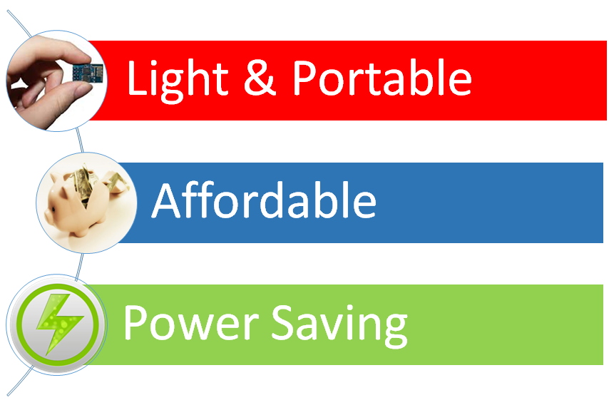
Feature

Slide 48
Future Works
Indoor Location Services
Mobile Alert

Slide 49


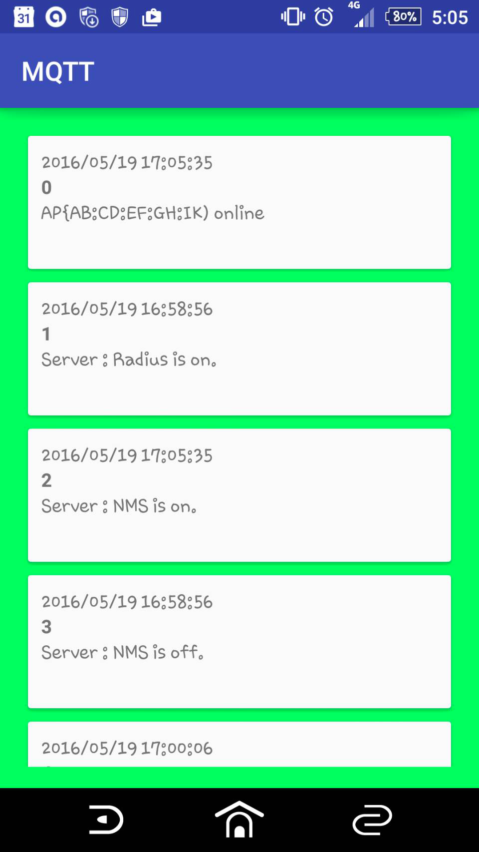
Mobile alert
SON algorithm
Server online/offline alert
Intrusion-detection alert

Slide 50
Thank you

